Slide 1

Object oriented programming in java
Objectifying everything

Slide 2
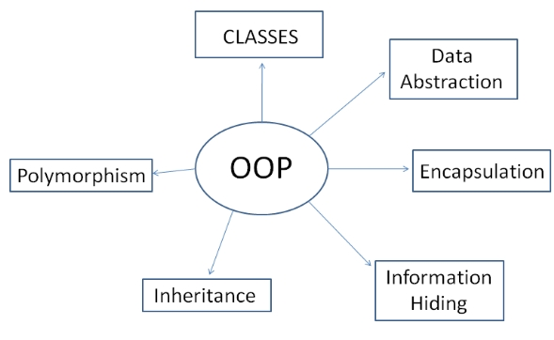
Contents covered
Introduction to OOP
Classes and Objects
Inheritance and Polymorphism
The Constructor
Uses of “this” and “super”
Overloading and Overriding
Static, overriding and Exceptional Handling

Slide 3
introduction
Object-Oriented Programming is a methodology or paradigm to design a program using classes and objects. It simplifies software development and maintenance by providing the following concepts:
1. Objects
2. Class
3. Inheritance
4. Polymorphism
5. Abstraction
6. Encapsulation

Slide 4
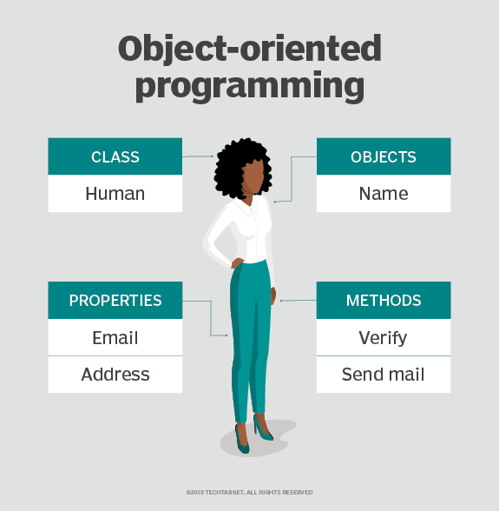

Slide 5
Class and objects
A class is a user defined blueprint or prototype from which objects are created.
It represents the set of properties or methods that are common to all objects of one type.
It is a logical entity that consumes no memory by itself.
An object is a entity that has both state and behavior.
It can be both physical and logical.
Examples of objects include chair, car, table, keyboard, a person, etc.

Slide 6
Inheritance and polymorphism
When one object acquires all the properties and behaviors of a parent object, it is known as inheritance.
It provides code reusability. It is used to achieve runtime polymorphism.
If one task is performed in different ways, it is known as polymorphism. For example: to convince the customer differently, to draw something, for example, shape, triangle, rectangle, etc.
In Java, we use method overloading and method overriding to achieve polymorphism.

Slide 7
Constructor
In Java, a constructor is a block of codes similar to the method. It is called when an instance of the class is created. At the time of calling constructor, memory for the object is allocated in the memory.
It is a special type of method which is used to initialize the object.
It calls a default constructor if there is no constructor available in the class. In such case, Java compiler provides a default constructor by default.
It can be used to perform any task or operation in addition to object creation such as starting a thread, calling a method, etc.
Does constructor return anything?

Slide 8
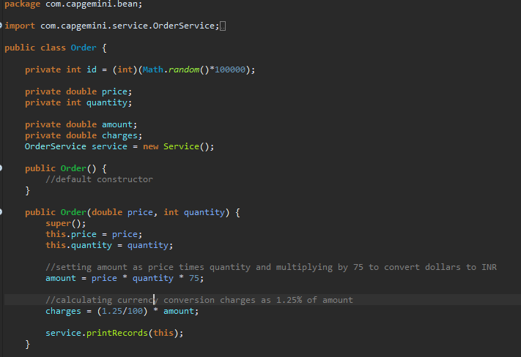

Slide 9
This and super
this can be used to refer current class instance variable.
this can be used to invoke current class method (implicitly)
this() can be used to invoke current class constructor.
this can be passed as an argument in the method call.
this can be passed as argument in the constructor call.
this can be used to return the current class instance from the method.
super is used to call constructor of superclass.
super can also be used to invoke parent class’ methods as well.
super is also used for referring to parent class’ variables.
Where you can’t use this and super???

Slide 10
Overloading and overriding
If a class has multiple methods having same name but different in parameters, it is known as Method Overloading (Operator overloading??)
There are two ways to overload the method in java-
1. By changing number of arguments
2. By changing the data type
If subclass (child class) has the same method as declared in the parent class, it is known as method overriding in Java.
Method overriding is used to provide the specific implementation of a method which is already provided by its superclass.
Method overriding is used for runtime polymorphism
Can we overload and override main method???

Slide 11
Static, overriding and exception handling
Static methods can’t be overridden.
“this” and “super” keywords can’t be used in static context.
There are 2 cases in overriding a method in a class:
If the method in superclass does not declare an exception
If it declares an exception

